Slide 1
Outage events in power grids: A large deviations approach
Jayakrishnan Nair (IIT Bombay)
Joost Bosman (CWI, Netherlands)
Bert Zwart (CWI, Netherlands)

Slide 2
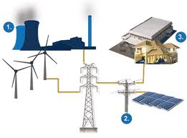
Conventional power grid
Generation
Load
controllable & reliable
predictable
Constraint: Generation = Demand, meeting physical line limits
Operators make control actions every 5-10 mins to enforce these
Little short-term uncertainty
Can assume grid is `static’ between control instants

Slide 3
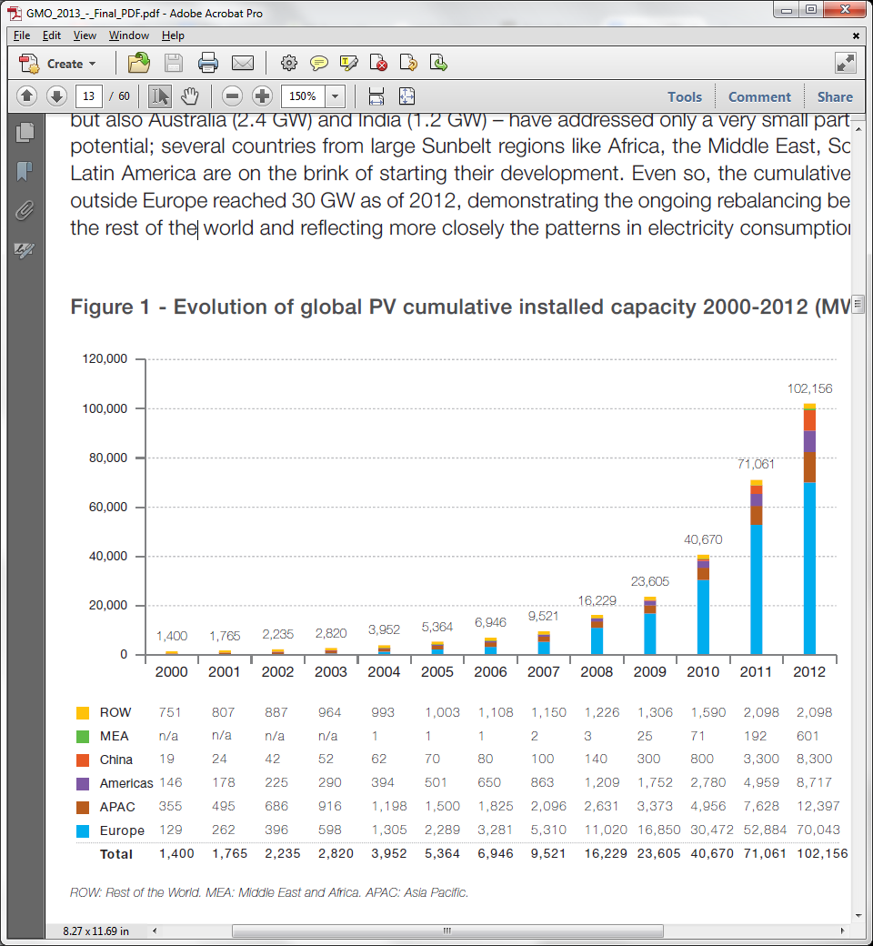
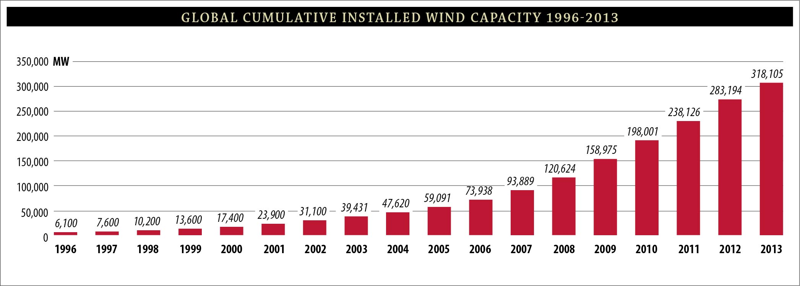
Now, renewable energy is exploding
MW
China
Americas
Solar PV:
Europe
MW
Wind:
Worldwide

Slide 4
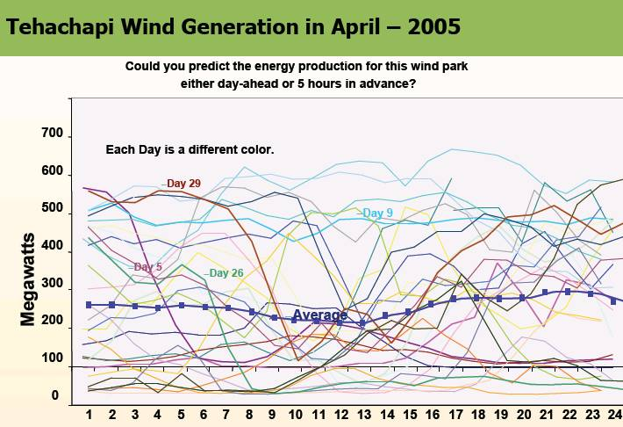
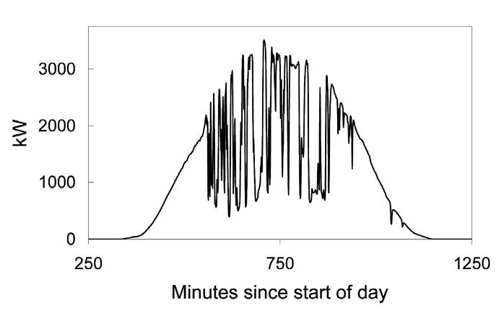
Solar PV output
Considerable short-term uncertainty!

Slide 5
Tomorrow’s power grid
Large deviations theory to answer design and control
problems in this space?
Can no longer assume grid is static in the short-term
Need stochastic models for sources
Probabilistic guarantees: Line constraint violation is a rare event

Slide 6
This talk
Large deviations -> capacity region characterizations
Temperature of power lines must remain within tight bounds
to avoid sag, loss of tensile strength
Conventional approach: Bound the current
In ‘stochastic’ framework, this is conservative
We demonstrate capacity gain from capturing temperature dynamics

Slide 7
Single transmission line

Slide 8
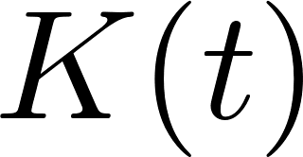
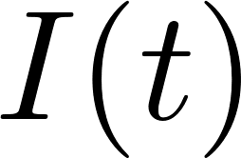
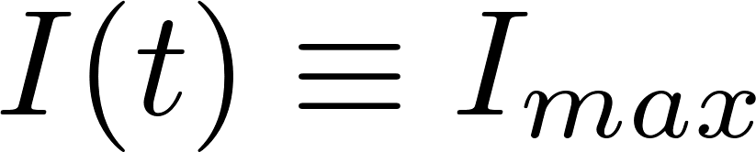

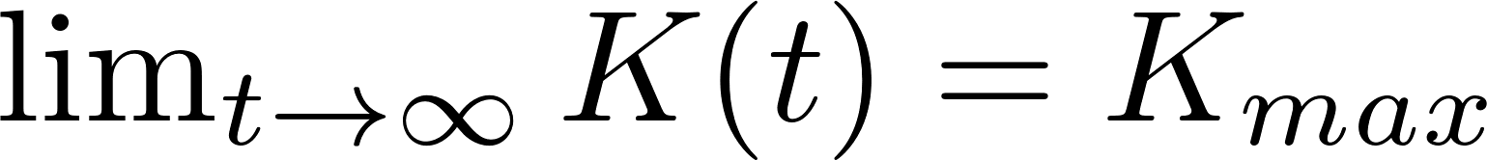

Slide 9
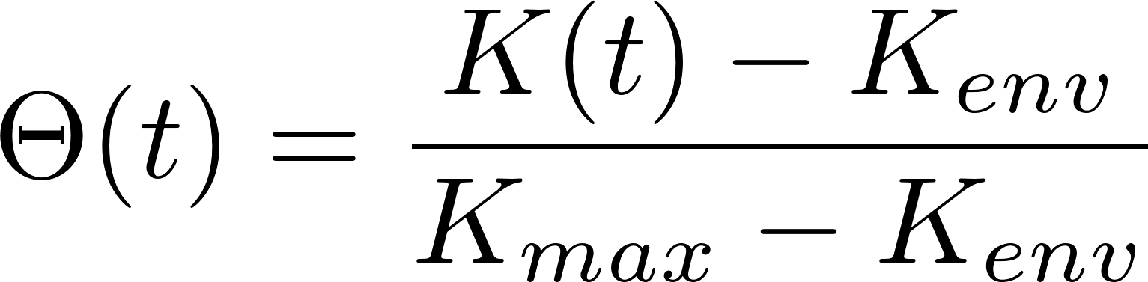
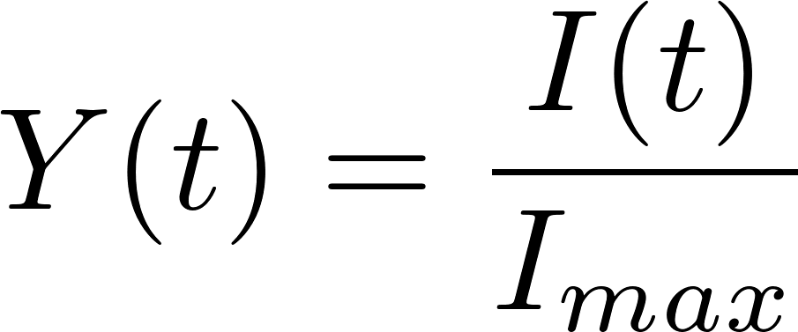
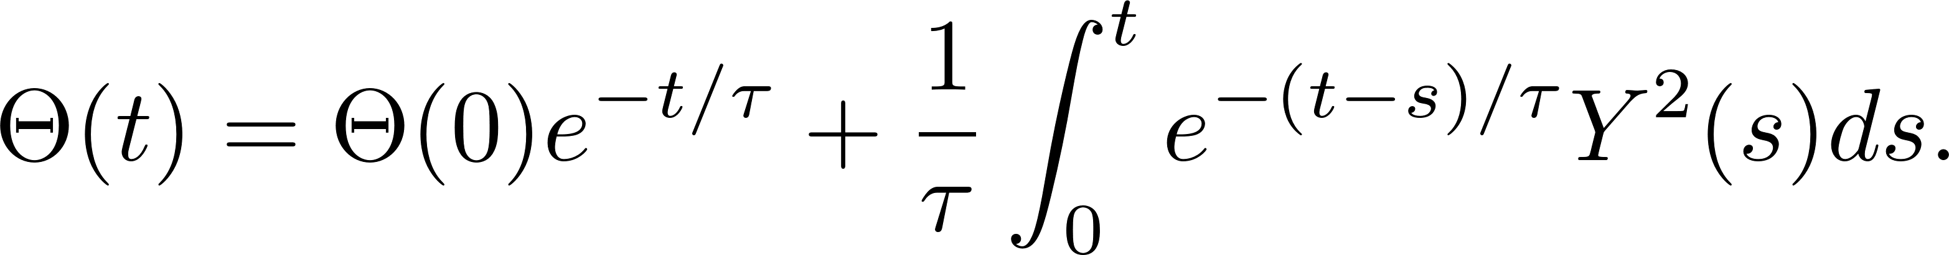
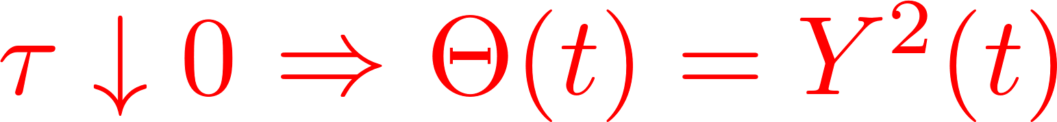

Slide 10
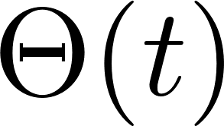
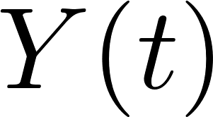
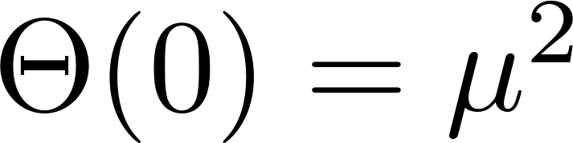
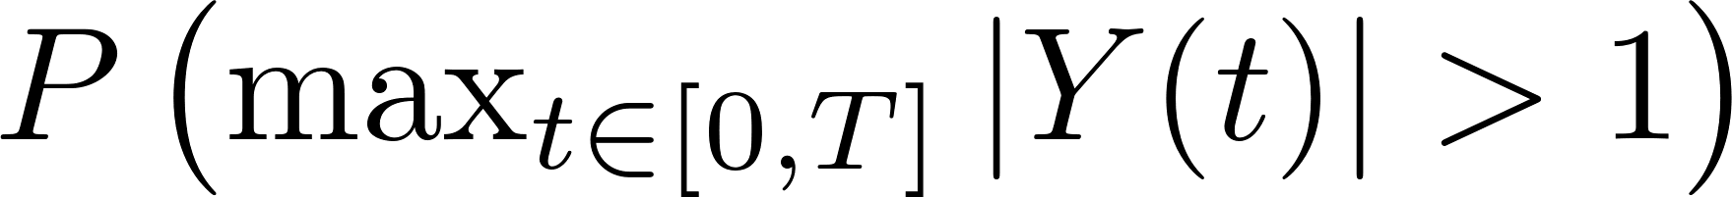
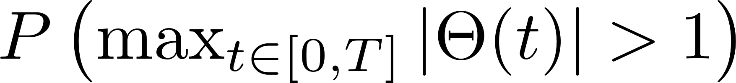

Slide 11
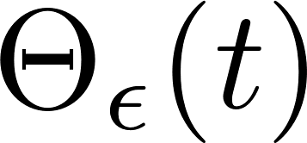
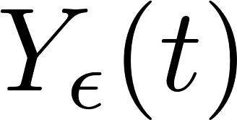
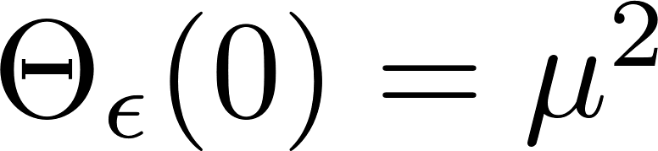
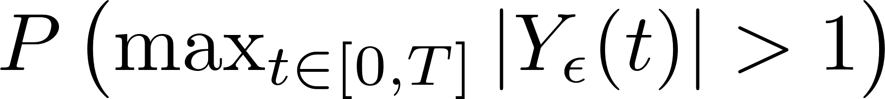
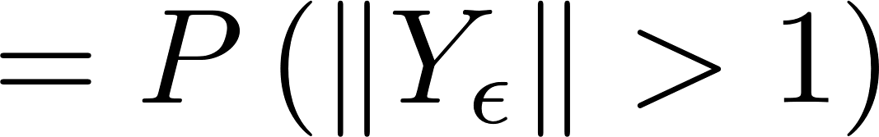
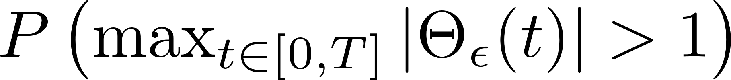
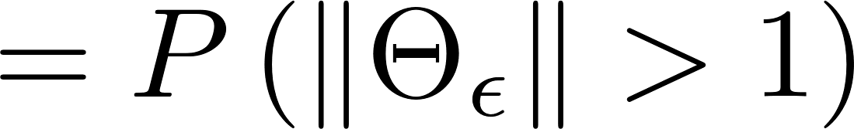

Slide 12
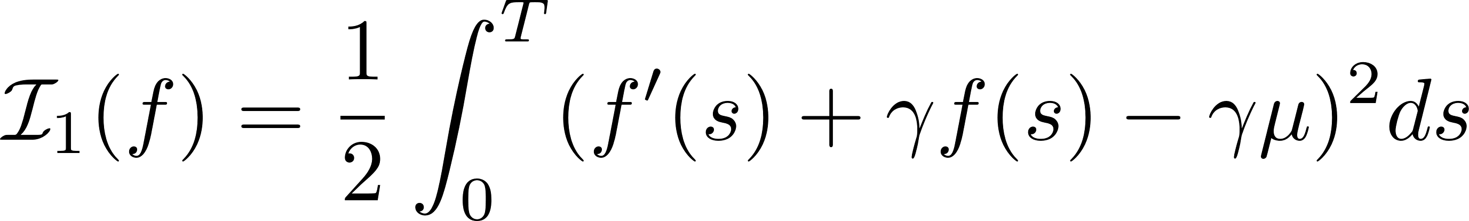
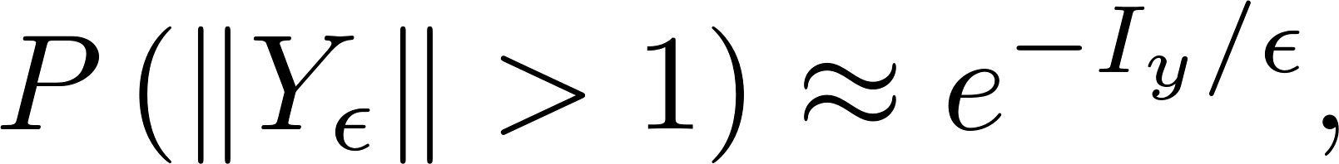
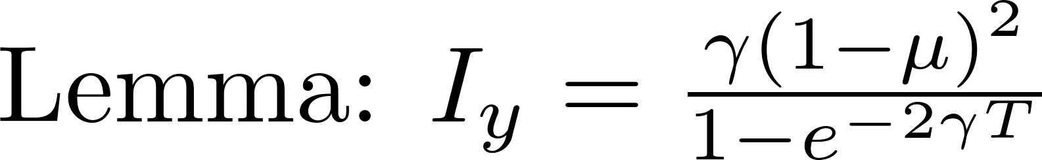
Current

Slide 13
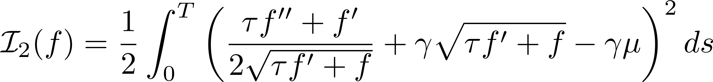
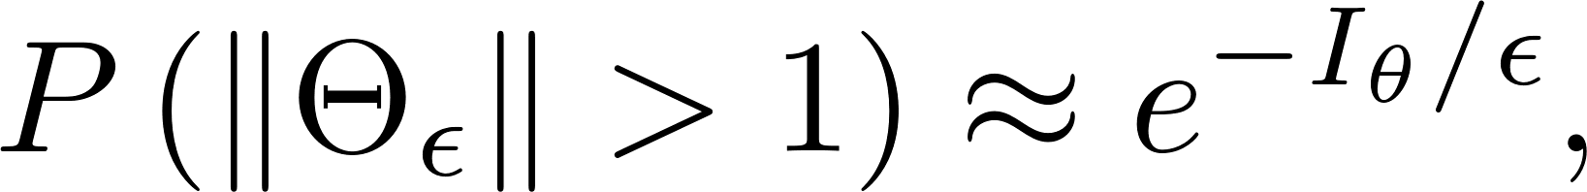
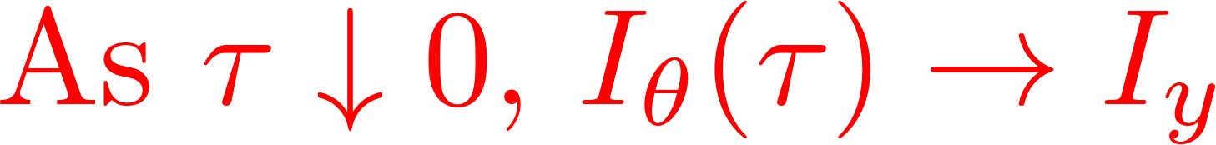
Temperature

Slide 14
Temperature

Slide 15
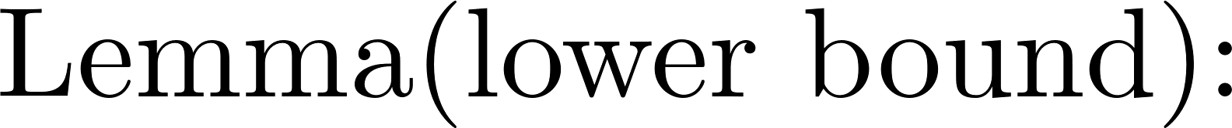
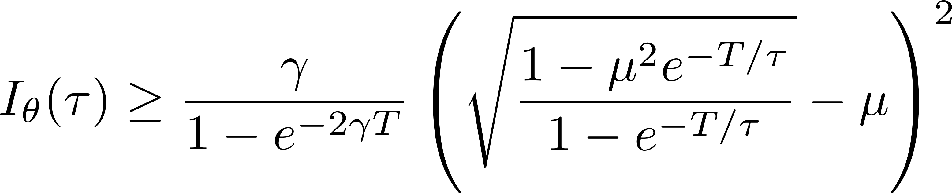

Temperature

Slide 16
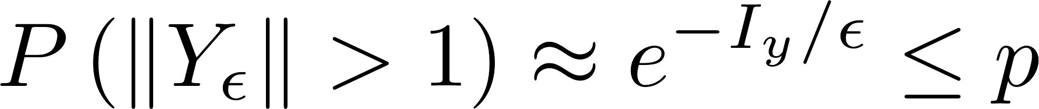
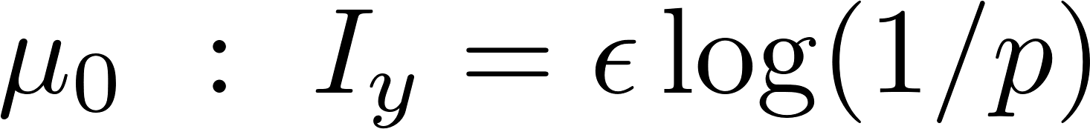
Capacity gain
Capacity set by current constraint
Capacity set by temp. constraint

Slide 17
Network of transmission lines

Slide 18

V,I
Power flow equations highly non-linear
Linearized model: DC approximation

Slide 19
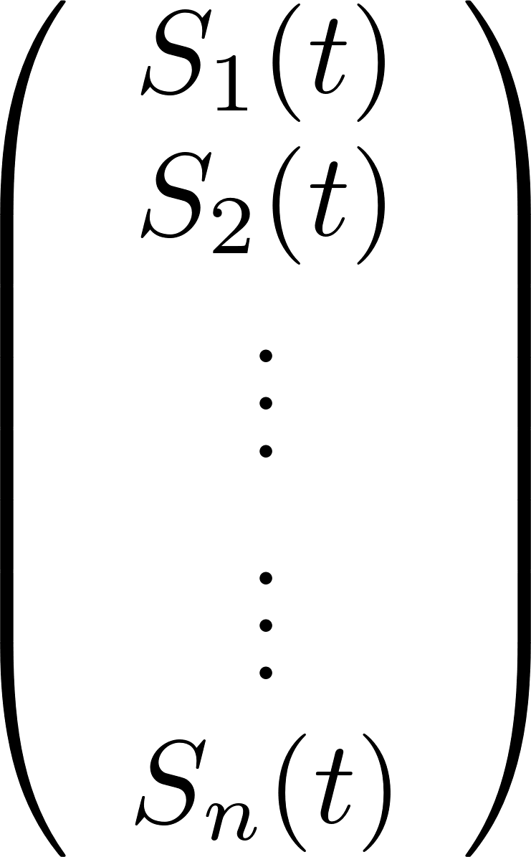
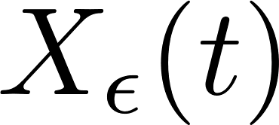

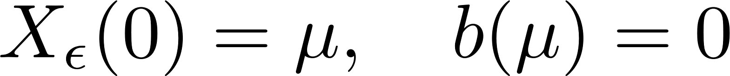
remain
fixed

Slide 20
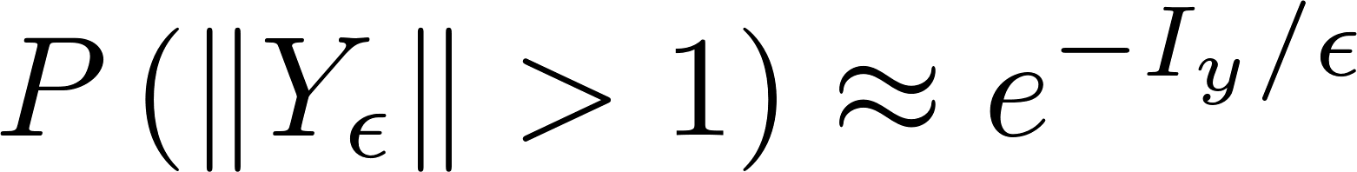
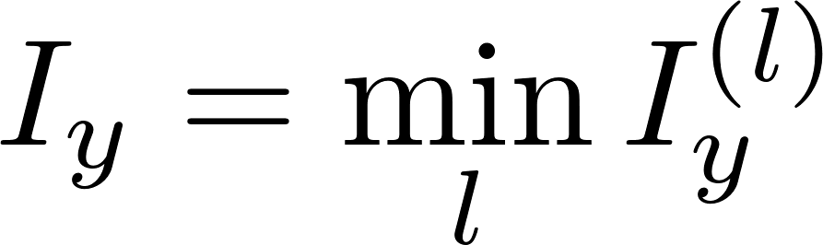
Current
probability of overflow on some link
Vector OU case => closed form
=> closed form for capacity region

Slide 21
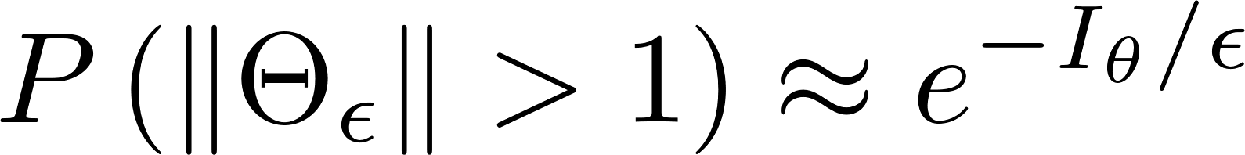
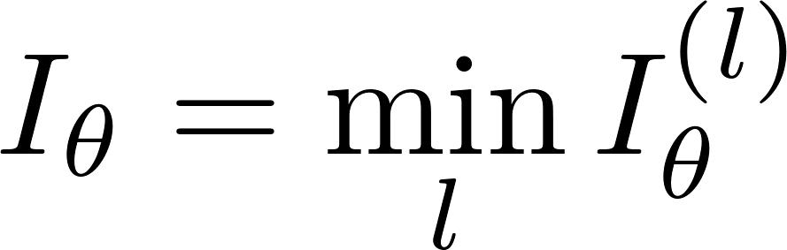
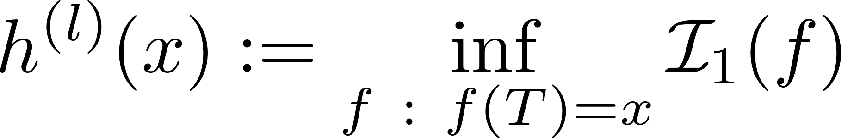
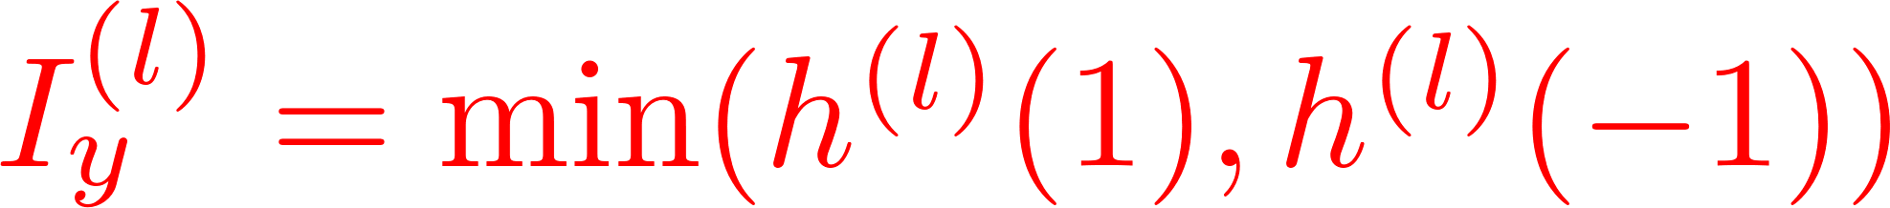
Temperature
probability of overflow on some link

Slide 22
Temperature
probability of overflow on some link
Vector OU case => closed form lower bound on capacity region

Slide 23
Under the DC approximation, can characterize capacity regions
for the network
Future work:
1. Validate DC approximation via Monte Carlo
2. Use DC approximation to speed Monte Carlo

Slide 24
Outage events in power grids: A large deviations approach
Jayakrishnan Nair (IIT Bombay)
Joost Bosman (CWI, Netherlands)
Bert Zwart (CWI, Netherlands)

