Slide 1
Adaptive CSMA under the SINR Model: Fast convergence using the Bethe Approximation
Krishna Jagannathan
IIT Madras
(Joint work with)
Peruru Subrahmanya Swamy
Radha Krishna Ganti

Slide 2
Overview
Problem:
Adaptive CSMA under the SINR model
Adaptive CSMA:
Throughput optimal, but impractically slow convergence (Exponential in the network size)
Our contribution:
Efficient and scalable method to compute CSMA parameters to support a desired service rate vector
Implications:
Convergence rate: Depends only on size of local neighborhood
Accuracy: related to the Bethe approximation
Robustness: Robust to changes in service rates and topology

Slide 3

Single hop network
Basic CSMA
Interferers

Slide 4
Basic CSMA
Some interferers are on
Link ‘i’ will not transmit
Link i

Slide 5

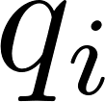
Basic CSMA
All interferers are off .
Link i
Access Probability at link i

Slide 6
Distributed scheduling & Throughput optimality
Maximum weight scheduling [Tassiulas & Ephremides]
Centralized
Throughput optimal
Adaptive CSMA [Jiang & Walrand], [Srikant et. al.], [Rajagopalan & Shah]
Distributed
Throughput optimal
Key idea: Adapt the attempt rates (fugacities) based on empirical service rates

Slide 7
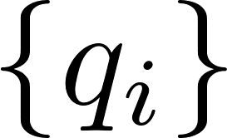

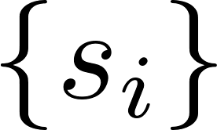
The forward and reverse problems
Access Probabilities
Forward Problem
Reverse Problem
NP- HARD
NP- HARD
Service Rates
Adaptive CSMA – Solves the reverse problem through SGD

Slide 8
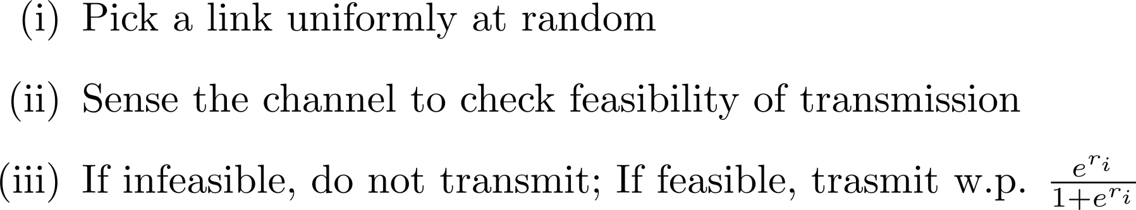
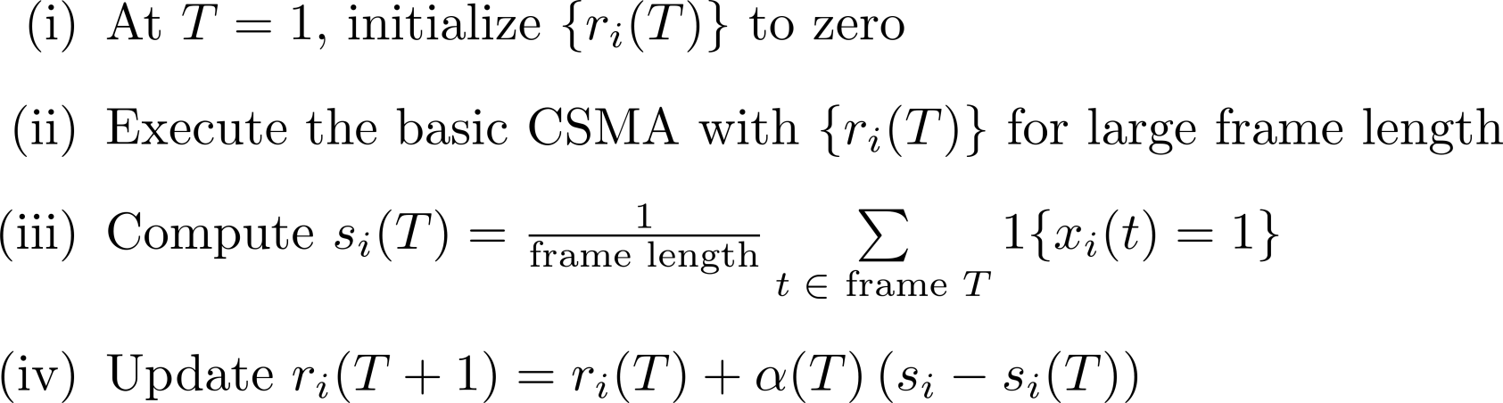
Adaptive CSMA [Jiang L, Walrand J]
Basic
CSMA:
Two Time scales:
t=1
2
3
4
5
T=1
T=2
T=3
Adaptive
CSMA:
Estimate of gradient

Slide 9
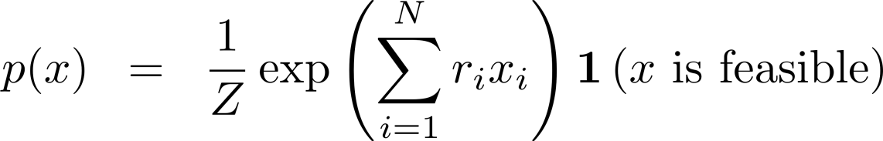
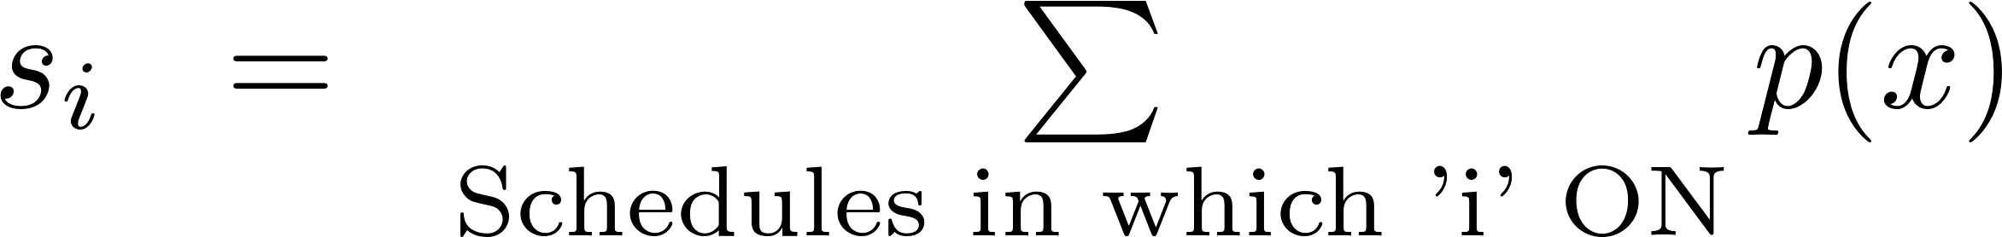
Stationary distribution and Service rates
The stationary distribution induced by the basic CSMA:
Normalization constant
Forward
problem
Reverse
problem
Service Rates:
Notes:
Tell about approximations

Slide 10
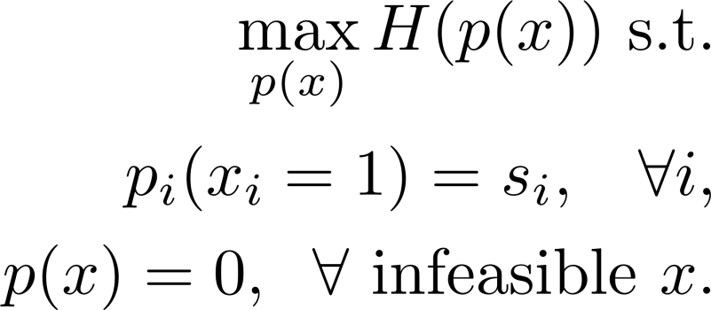
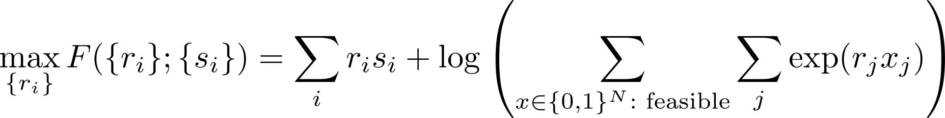
Fugacities to match the service rates
There exist fugacities to support any supportable service rates s_{i}
Maximum entropy
problem :
The dual problem of the maximum entropy problem gives the optimal fugacities
Global Gibbsian problem:
Adaptive CSMA – Stochastic gradient descent for global problem

Slide 11
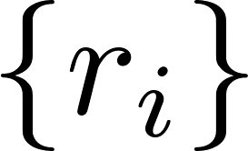
Drawbacks of Adaptive CSMA: Slow convergence
Adaptive
CSMA
(SGD for global problem)
Service rates
Global fugacities
Network size: 20
Large Frame size: Gradient estimate entails waiting for a long time (mixing)
SGD convergence : Requires very small step size to guarantee convergence

Slide 12
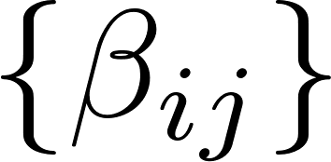
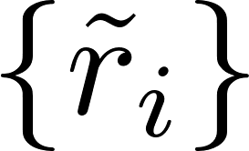
Our Contribution
Local
optimization
& combining
Service rates
Local solutions
Approx.
Global fugacities
Local optimization problems, motivated by the Bethe approximation
Estimate the global fugacities from local solutions
Order optimal convergence
Robustness to changes in topology and service rates

Slide 13

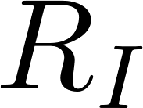
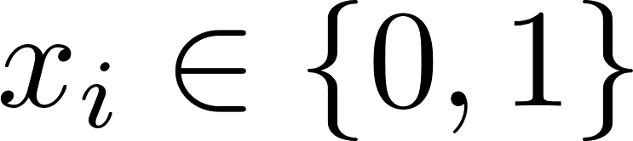
System Model
SINR Interference Model
Standard path loss model
Interference from the links within radius (Neighbors)
Successful link SINR > ᴦ
Transmit power and rate
Fixed transmit power
Slotted time model
Transmits one packet / slot
Notation
N: number of links
: ON/ OFF status of the link i
Notes:
Tell about approximations

Slide 14
The Local Gibbsian Problems
Global
Problem:
2 changes
Global problem Local problem
Remove all the links except neighbors
2. Ignore neighbors SINR Constraints

Slide 15
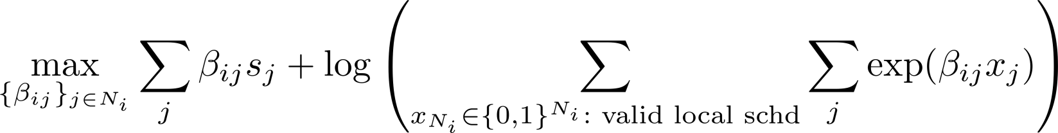

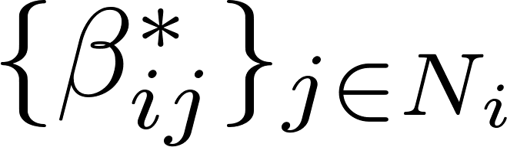
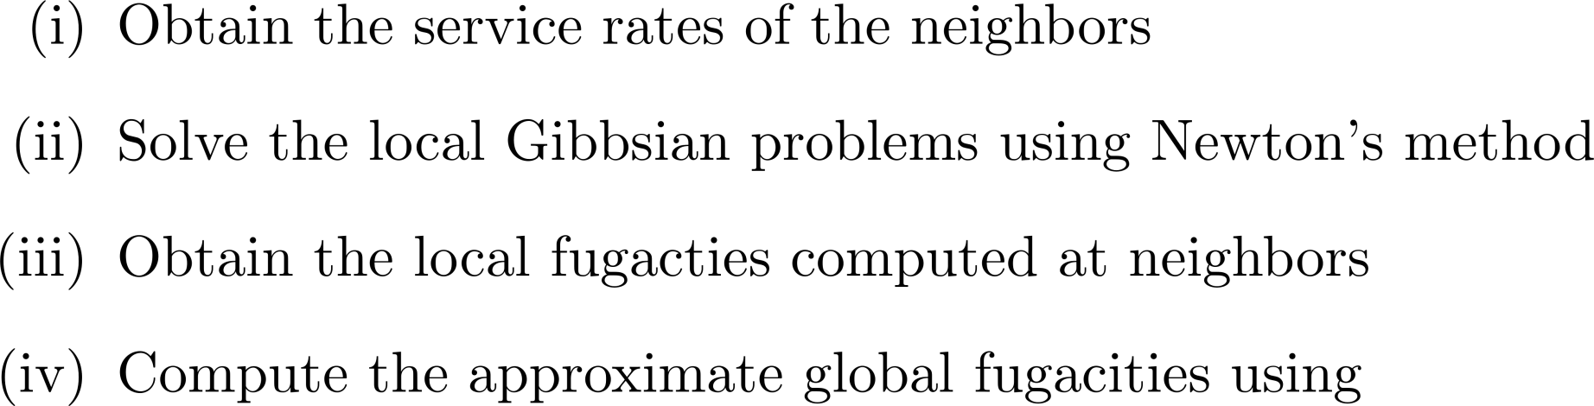
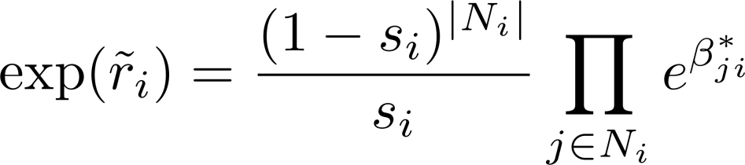
Local optimization method at link i
Local
Problem:
Algorithm
Input:
Output:

Slide 16
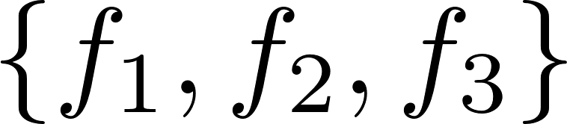



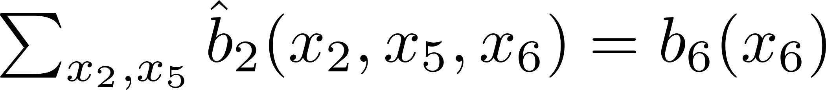
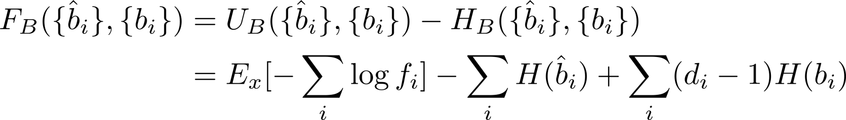
Bethe Free Energy (BFE)
Approx.
Factor marginals
Variable marginals
of
Bethe
Approx.
Variable marginals:
Factor marginals:
Consistency conditions:
BFE:

Slide 17
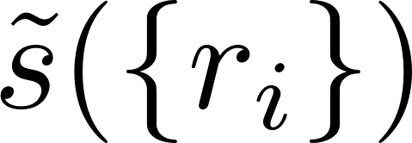
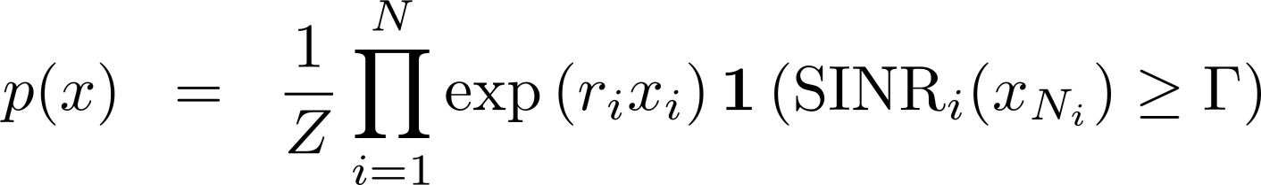
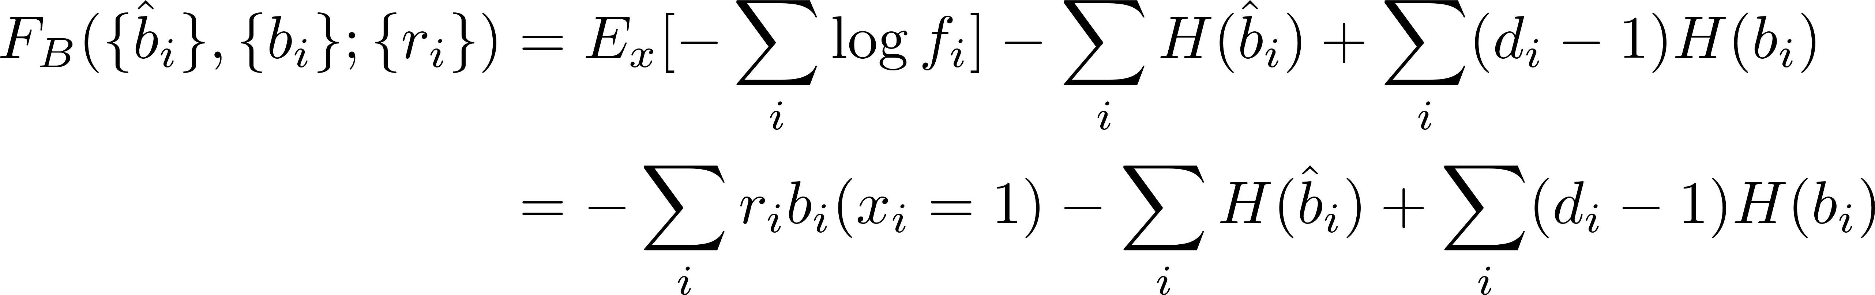
BFE in the context of CSMA
Approx.
factor marginals &
variable marginals
Bethe
Approx.
Global fugacities
Stationary distribution:
BFE parameterized by global fugacities:

Slide 18
Main Result
Our local optimization method is equivalent to solving the reverse problem of the Bethe approximation
Local
optimization
method
Bethe
Approx.
Service rates
Approx.
Global fugacities
variable marginals
Theorem: Let be the approximate fugacities obtained using our algorithm. Then these are the unique fugacities for which, the desired serviced rates can be obtained as the stationary points of the BFE parameterized by .

Slide 19
Proof Outline
Approx.
factor marginals &
variable marginals
Bethe
Approx.
Global fugacities
Challenges in the reverse problem
We have only single-node marginals (service rates) with us. What should we do about factor marginals ? (Lemma 1)
Can we express the fugacities in terms of factor and variable marginals ? (Lemma 2)

Slide 20

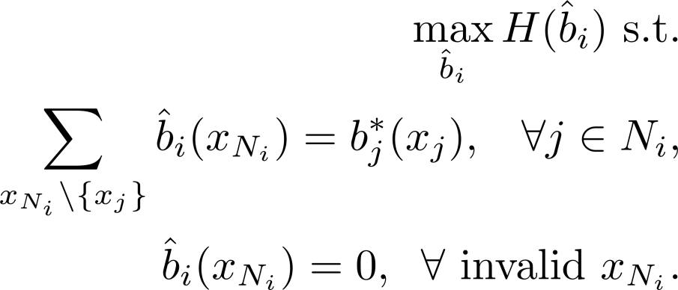
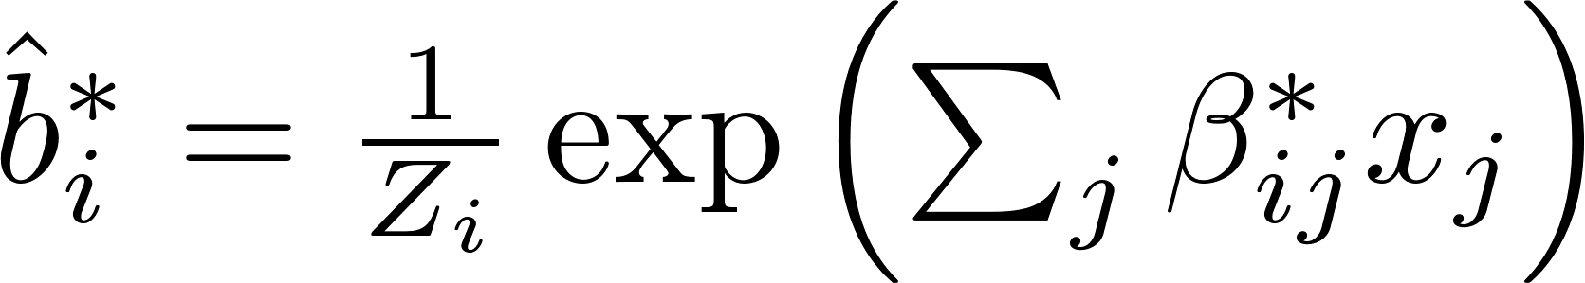
Lemma 1: Factor marginals maximise entropy
a. Characterize the stationary points of the Bethe free energy
Lemma 1: The factor marginals at a stationary point of the BFE have a maximal entropy property subject to the local consistency constraints, i.e,
b. The local Gibbsian problems are essentially dual problems of the local maximum entropy problems with local fugacities being the dual variables. Further, the factor marginals and the dual variables are related as

Slide 21
Lemma 2: Global fugacities in terms of local solutions
Lemma 2: Approximate global fugacites can be obtained as closed form functions of the factor marginals. Specifically, the global fugacities are related to the local fugacities that define the factor marginals as

Slide 22
Numerical results: Interference graph
A randomly generated network of size 15
Each node corresponds to link in the network.
Two nodes share edge if they are within interference range R_{I}

Slide 23
Convergence rate of local algorithm
Norm of gradient
Iteration
Y-axis: Gradient of the local Gibbsian objective function
Typically converges in 3 to 4 iterations (strict convexity and Newton’s method)

Slide 24
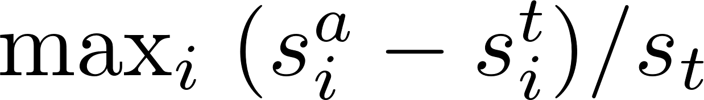
Comparison with SGD based Adaptive CSMA
Y-axis: Normalized error :
Simulated on randomly generated of network sizes 15 and 20
SGD is run for 10^10 slots, our algorithm: 3-5 iterations!

Slide 25
Concluding remarks
Considered the adaptive CSMA algorithm under the SINR model
Approximated the global Gibbsian problem by using local Gibbsian problems
Proved equivalence to the reverse of the Bethe approximation
Order optimal convergence; Robustness to changes in topology and service rates

