Slide 1
An Information Processing View of Reaction Networks
Manoj Gopalkrishnan
TIFR Mumbai
manoj.gopalkrishnan@gmail.com

Slide 2
Here is a Markov chain
1
2
Master Equation
3
Here is a reaction network
Law of Mass Action
Continuous-time discrete-space Markov chain = Unimolecular reaction network

Slide 3
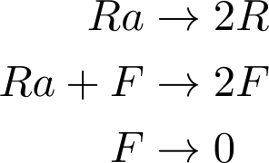
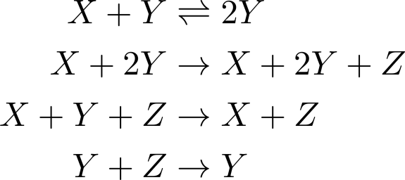
Reaction networks allow rich dynamics
explodes in finite time.
oscillates for all values of the rate constants.
has same phase portrait as Lorentz attractor
--- well-known model for chaos.
has same phase portrait as
the simple harmonic oscillator
Notes:
Expressivity is both a blessing and a curse. It allows you to describe all sorts of systems, but it becomes too much to hope for a general theory.

Slide 4
Surprise: powerful theorems exist!
Dynamical
Systems
Combinatorics
Reaction
Networks
Algebraic
Geometry
Information
Theory
Statistical
Mechanics
Notes:
If it is such a powerful thing, why hasn’t it been discovered before, by other people, in other fields?

Slide 5
Reaction Networks by Other Names
Carl Petri:
Distributed computer systems
[Petri nets 1962].
Craciun et al.
Toric Differential Inclusions
John Baez:
Symmetric monoidal category
Population genetics:
Recombination equations
Reaction
Networks
Craciun et al.
Toric Dynamical Systems
Rabinovich/ Sinclair/ Wigderson/ Arora/ Vazirani:
Quadratic Dynamical Systems

Slide 6
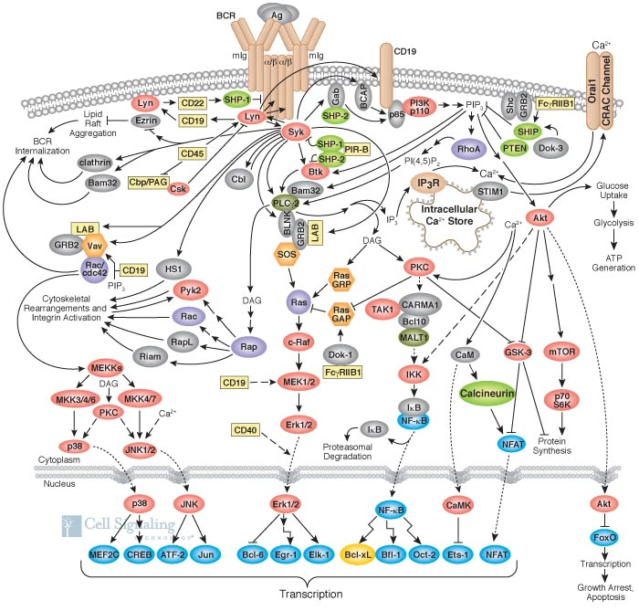
Biochemical Reaction Networks
Notes:
“In building a design theory for chemistry, chemical reaction networks are usually the most natural intermediate representation - the middle of the hourglass [10]. Many different high level languages and formalisms have been and can likely be compiled to chemical reactions, and chemical reactions themselves (as an abstract specification) can be implemented with a variety of low level molecular mechanisms.” --- Oishi/ Klavins
About 10 years ago, this area had only about a dozen people actively working in it. Today, primarily because of the interest from the side of biolochemical reaction networks, there is an active community

Slide 7
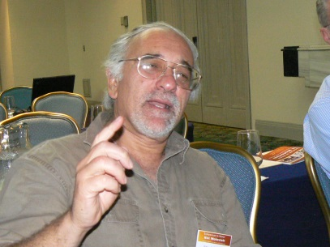
Community http://reaction-networks.net/
Muhammad Ali Al-Radhawi
Zahra Aminzare
David Anderson
David Angeli
Murad Banaji
Julio Banga
Balázs Boros
Daniele Cappelletti
Gheorghe Craciun
Carsten Conradi
Patrick De Leenheer
Alicia Dickenstein
Mirela Domijan
Pete Donnell
Martin Feinberg
Elisenda Feliu
Dietrich Flockerzi
Attila Gabor
Gilles Gnacadja
Manoj Gopalkrishnan
Alexander Gorban
Jeremy Gunawardena
Juliette Hell
Bill Helton
Bayu Jayawardhena
John Baez
Matthew Johnston
Badal Joshi
Igor Klep
Bence Mélykúti
Nicolette Meshkat
Ezra Miller
Maya Mincheva
Mark Muldoon
Stefan Müller
Jost Neigenfind
Zoran Nikoloski
Irene Otero-Muras
Casian Pantea
Mercedes Perez Millan
Shodhan Rao
Georg Regensburger
Alan Rendall
Anne Shiu
David Siegel
Guy Shinar
Eduardo Sontag
Gabor Szederkenyi
Janos Toth
Carsten Wiuf
Pencho Yordanov

Slide 8
Outline
Reaction Networks = Markov Chains++
ODE modeling: Mass-action kinetics
Lyapunov function
Stochastic modeling: Chemical master equation
Relative entropy, stationary distributions
Story 1: Ergodic theorem for reaction networks
Story 2: Lyapunov function from relative entropy
Story 3: Using reaction networks to do statistical estimation.

Slide 9
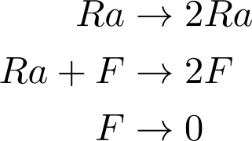
Definition: Reaction Network
Fix a finite set S of species
Reaction Network: Graph (C,R) with vertices in .
C: Complexes
R: Reactions
More generally allow
Example: Lotka-Volterra system
F
(0,2)
(0,1)
(1,1)
Ra
(0,0)
(1,0)
(2,0)

Slide 10
Example: Mass-action kinetics
F
(0,2)
(0,1)
(1,1)
Ra
(0,0)
(1,0)
(2,0)

Slide 11
Definition: Mass-Action Kinetics
Rate function k for reaction network (C,R)
Takes reaction
To positive real
Notation:
Flow
Mass-action kinetics

Slide 12
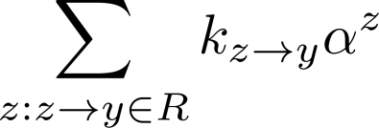
Definition: Complex Balance
Reaction network (C,R) is complex balanced iff
there exists such that
for all complexes
inflow = outflow
y
y’
z
…
…

Slide 13
Definition: Stoichiometric Subspace
Note:
The stoichiometric subspace H of (C,R) is
Lemma:
Corollary:
The invariant polytope P(x) of is

Slide 14
Story 1: Global Attractor Conjecture
Birch’s Theorem: Complex-balanced system (S,C,R,k,α)
Every invariant polytope P(x)
contains a unique positive fixed point x*.
Further x* is a point of complex balance.
Proof: Using Lyapunov function
Ergodic Theorem : Global Attractor Conjecture
Open [Horn 1974]: x* = global attractor in P(x)
Notes:
Let me try to give you an intuitive feel for why the global attractor conjecture isn’t obvious. You might think that we have a strictly convex Lyapunov function, doesn’t that do the trick? Consider this.

Slide 15
Global Attractor Conjecture
P(x)
x*
Lyapunov’s Theorem

Slide 16
Global Attractor Conjecture
P(x)
x*

Slide 17
Story 2: Origins of the Lyapunov function
Lyapunov function
Relative entropy
Reaction
Networks
Lyapunov function = Relative entropy
Lyapunov function = Free energy
Information
Theory
Szilard-Landauer principle
∆Free energy = Relative entropy
Statistical
Mechanics

Slide 18
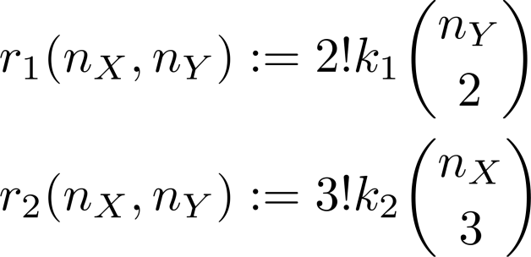
Stochastic Model of Reaction Networks
Kurtz 1972
Mass-action ODE is volume limit of the stochastic model.

Slide 19
Stochastic Model of Reaction Networks
Anderson/Craciun/Kurtz 2010
If (S,C,R,k) is complex-balanced
then stationary distribution is product of Poissons.

Slide 20
Stochastic Model of Reaction Networks
Anderson/Craciun/G/Wiuf 2015
If (S,C,R,k) is complex-balanced
then ODE Lyapunov function
is the volume limit
of entropy relative to the stationary distribution
for the stochastic model.

Slide 21
Story 3: Intelligent Chemical Soups
Notes:
“In building a design theory for chemistry, chemical reaction networks are usually the most natural intermediate representation - the middle of the hourglass [10]. Many different high level languages and formalisms have been and can likely be compiled to chemical reactions, and chemical reactions themselves (as an abstract specification) can be implemented with a variety of low level molecular mechanisms.” --- Oishi/ Klavins

Slide 22
Computing with Reaction Networks
Turing machines
Boolean circuits [Winfree, Qian]
Linear input/ output systems [Oishi, Klavins]
Analog electronic circuits [Daniel et al.]
Algebraic functions [Buisman et al.]
Computing marginals of a joint distribution [Napp, Adams]
...
Find: A model of computation native to reaction networks
Proposal: Statistical Inference

Slide 23
Log-linear Models
“arguably the most popular and important statistical models for the analysis of categorical data”
“include as special cases graphical models as well as many logit models”
“applications in social and biological sciences... privacy…, medicine, data mining, language processing and genetics…”
Stephen E Fienberg and Alessandro Rinaldo, Maximum likelihood estimation in log-linear models.
The Annals of Statistics, 40(2):996–1023, 2012.

Slide 24
Log-linear model: Example
Design Matrix:
Outcomes: X₁, X₂, X₃
Parameters: θ₁, θ₂
Model:
Pr[ X₁ | θ₁, θ₂ ] ∝ θ₁²
Pr[ X₂ | θ₁, θ₂ ] ∝ θ₁ θ₂
Pr[ X₃ | θ₁, θ₂ ] ∝ θ₂²

Slide 25
Log-linear model: Maximum Likelihood
Several independent trials
u₁ = frequency of X₁
u₂ = frequency of X₂
u₃ = frequency of X₃
Maximum likelihood estimator (MLE)
Maximum likelihood distribution (MLD)
Pr[X₁ | θ₁, θ₂] ∝ θ₁²
Pr[X₂ | θ₁, θ₂] ∝ θ₁ θ₂
Pr[X₃ | θ₁, θ₂] ∝ θ₂²

Slide 26
Recipe for MLD from Reaction Networks
Take design matrix A
Compute basis of ker(A)
Each basis element =>
reversible reaction
Frequency data => initial conditions
Apply mass-action kinetics with unit rates
Thm: Equilibrium point is MLD
X₁ + X₃ ⇌ 2X₂
x(0) = (u₁, u₂, u₃)

Slide 27
Why does this work?
Toric geometry in log-linear models and reaction networks [Craciun et al. 2009, Miller 2011]
MLD p* maximizes Shannon entropy subject to Ap=Au
Arrange reaction network constraints to match MLD problem
reactions ~ ker(A)
Mass-action kinetics maximizes entropy
reversible reactions, unit rates
Uniqueness of this maximizer
Global convergence: The dynamics reaches the maximizer
Most of our effort: proving global convergence

Slide 28
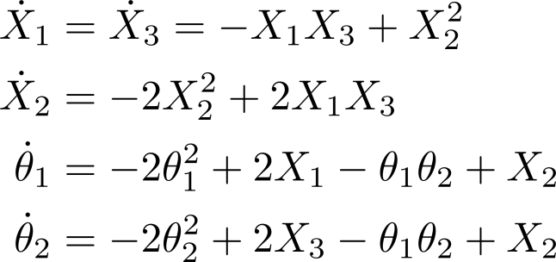
Recipe for MLE from Reaction Networks
Compute basis for ker A
Each basis element => reversible reaction
Add 2 irreversible reactions per column for MLE readout.
Convert frequency data into initial conditions
Apply mass-action kinetics with unit rates
Thm: Equilibrium is (MLD, MLE)
X₁ + X₃ ⇌ 2X₂

Slide 29
From Design Matrix to Reaction Network
Given:
Design matrix A = (a_{ij})_{mxn}
a_{ij} are integers
Column sums equal
Basis B for the free group Z^{n}∩ker A
Define reaction network (S_{MLD}, R_{MLD})
Species X₁, X₂, …, X_{n}
For each b∈B, a reversible reaction
Define reaction network (S_{MLE}, R_{MLE})
Species X₁, X₂, …, X_{n}, θ₁, θ₂, …, θ_{m}
All reactions in R_{MLD}
For each column j of A, reactions and

Slide 30
Results
Theorem: Mass-action kinetics on (S_{MLD}, R_{MLD}, 1) computes the maximum likelihood distribution.
Theorem: Mass-action kinetics on (S_{MLE}, R_{MLE}, 1) computes the maximum likelihood estimator.

Slide 31
A Scheme for Molecular Computation of Maximum Likelihood Estimators
for Log-Linear Models
arXiv:1506.03172 We propose a scheme for computing Maximum Likelihood Estimators for Log-Linear models using reaction networks, and prove its correctness. Our scheme exploits the toric structure of equilibrium points of reaction networks. This allows an efficient encoding of the problem, and reveals how reaction networks are naturally suited to statistical inference tasks. Our scheme is relevant to molecular programming, an emerging discipline that views molecular interactions as computational primitives for the synthesis of sophisticated behaviors. In addition, such a scheme may provide a template to understand how biochemical signaling pathways integrate extensive information about their environment and history.

Slide 32
References: Global Attractor Conjecture
[GMS1]: A projection argument for differential inclusions, with applications to persistence of mass-action kinetics. Gopalkrishnan, Miller, Shiu, SIGMA 2013, 9 (0), 25-25
[GMS2]: A geometric approach to the Global Attractor Conjecture. Gopalkrishnan, Miller, Shiu, SIAM J. Appl. Math. 2014, 13 (2), 758-797.
[CNP]: Persistence and permanence of mass-action and power-law dynamical systems. Craciun, Nazarov, Pantea, arXiv:1010.3050v1.
[A]: Global asymptotic stability for a class of nonlinear chemical equations, Anderson, SIAM J. Appl. Math. 68 (2008), no. 5, 1464–1476.

Slide 33
References: Lyapunov function origins
Thomas G. Kurtz, The relationship between stochastic and deterministic models for chemical reactions, J. Chem. Phys. 57 (1972), no. 7, 2976–2978.
David F. Anderson, Gheorghe Craciun, and Thomas G. Kurtz, Product-form stationary distributions for deficiency zero chemical reaction networks, Bull. Math. Biol. 72 (2010), no. 8, 1947–1970.
David F. Anderson, Gheorghe Craciun, Manoj Gopalkrishnan, and Carsten Wiuf, Lyapunov functions, stationary distributions, and non-equilibrium potential for reaction networks , arXiv:1410.4820

Slide 34
References: Statistical Inference
Manoj Gopalkrishnan, A Scheme for Molecular Computation of Maximum Likelihood Estimators for Log-Linear Models, arXiv:1506.03172.
Gheorghe Craciun, Alicia Dickenstein, Anne Shiu, and Bernd Sturmfels. Toric dynamical systems. Journal of Symbolic Computation, 44(11):1551–1565, 2009. In Memoriam Karin Gatermann.
Nils E Napp and Ryan P Adams. Message passing inference with chemical reaction networks. In Advances in Neural Information Processing Systems, pages 2247–2255, 2013.
L. Pachter and B. Sturmfels. Algebraic Statistics for Computational Biology. Number v. 13 in Algebraic Statistics for Computational Biology. Cambridge University Press, 2005.
David Soloveichik, Georg Seelig, and Erik Winfree. DNA as a universal substrate for chemical kinetics. Proceedings of the National Academy of Sciences, 107(12):5393–5398, 2010.
Thanks: Gheorghe Craciun, Nick Jones, Anne Shiu, Abhishek Behera, Ezra Miller

